Slide 1
Tesla
Community Solar
Jerry Yip
jerry.yip@gmail.com

Slide 2

Tesla’s mission is to accelerate the world’s transition to sustainable energy.

Slide 3
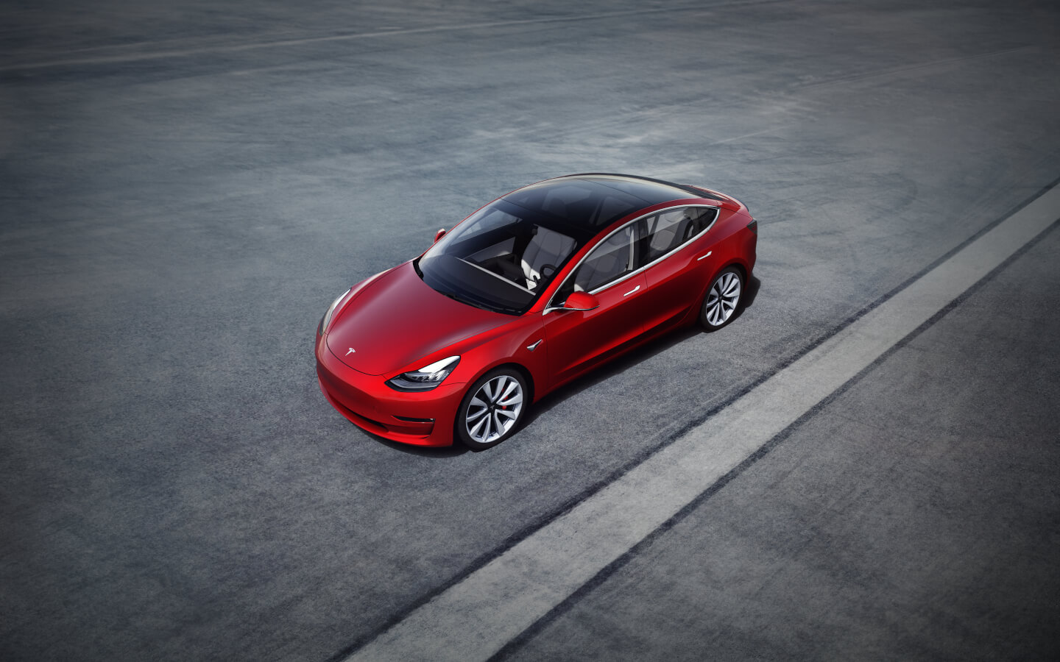
Tesla Cars
Tesla Cars

Slide 4
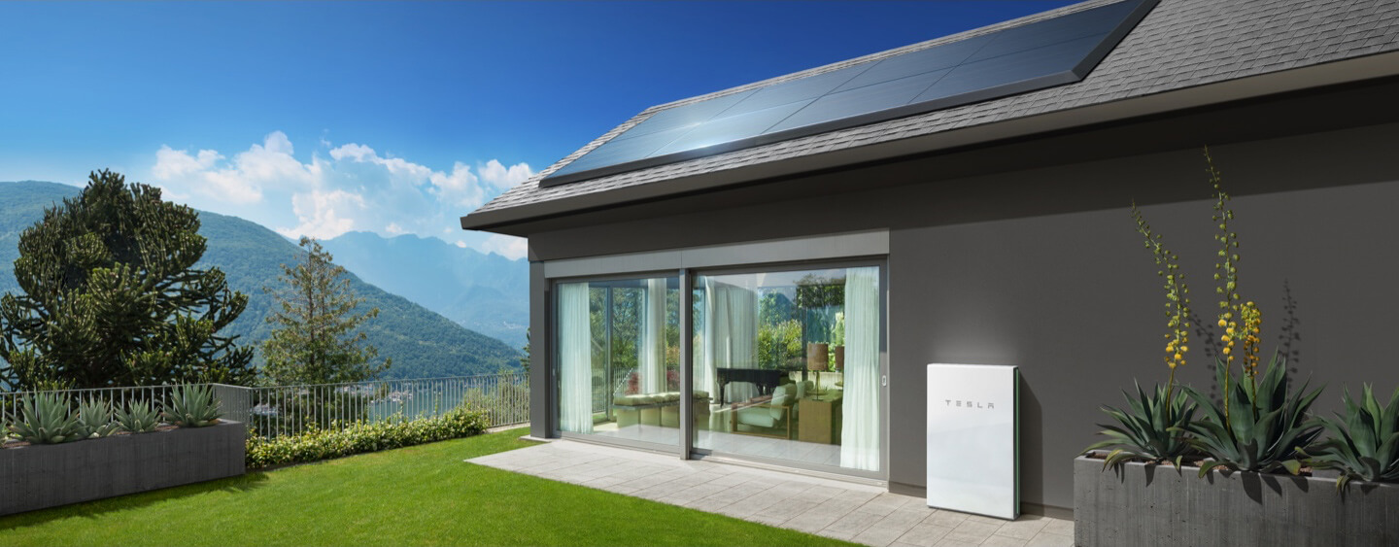
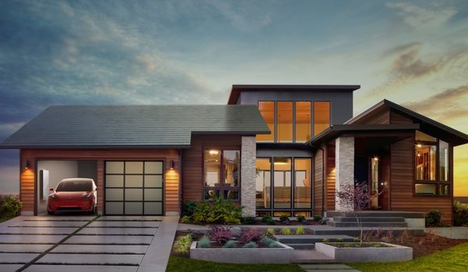
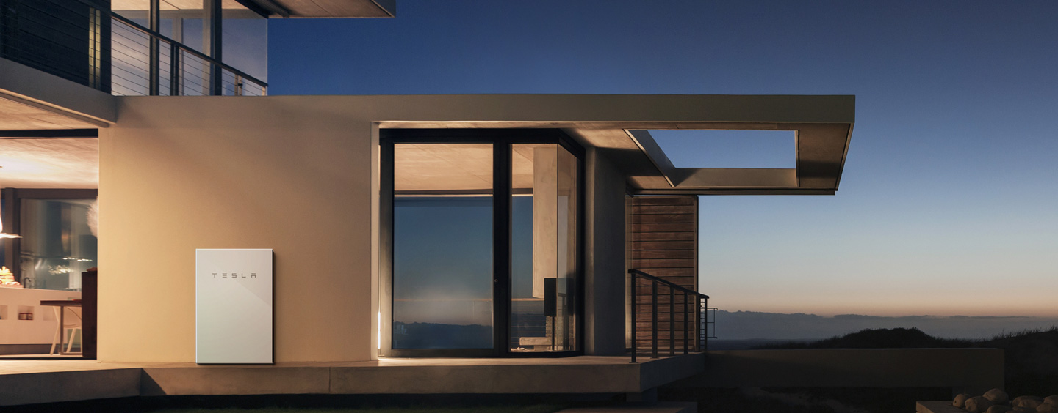
Tesla Energy
Tesla Solar Panels
Tesla Solar Roof
Tesla Home Batteries

Slide 5
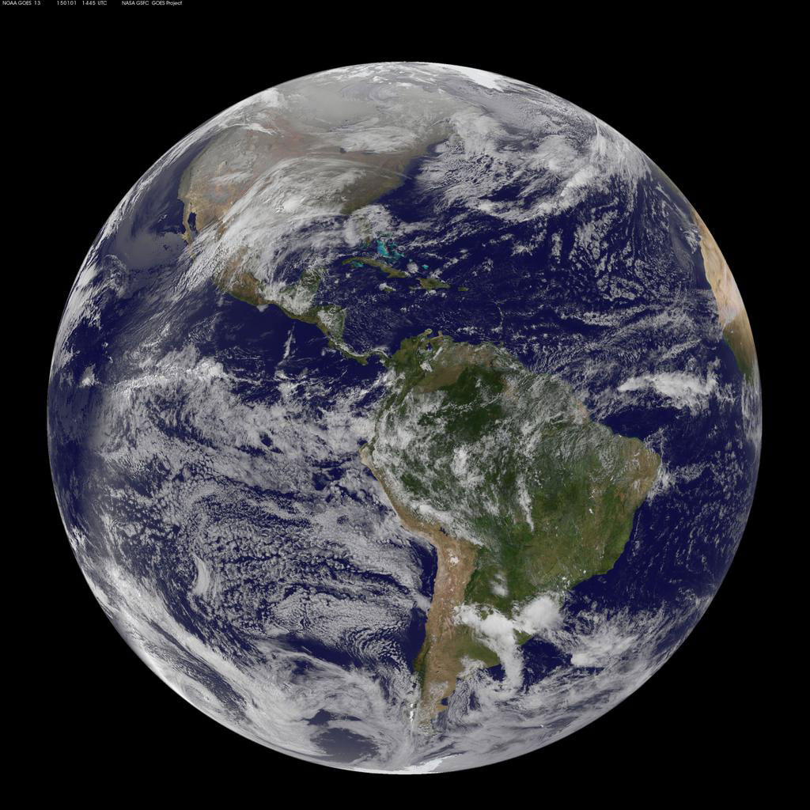
Environment

Slide 6
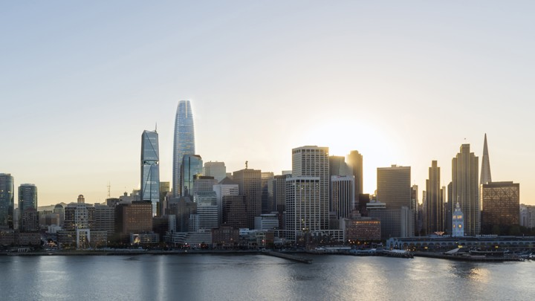
Modern Day Living

Slide 7
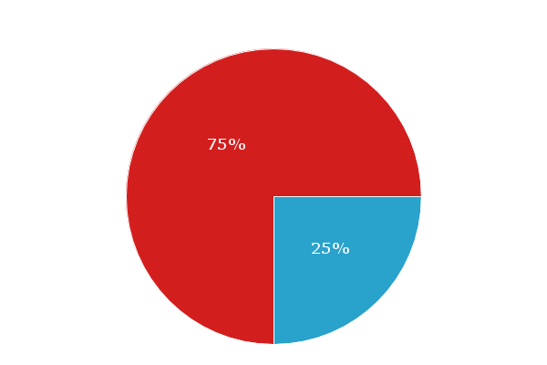
Statistics
~77% of homes can’t support solar
https://solstice.us/solstice-blog/why-americans-cant-access-rooftop-solar/

Slide 8
Opportunity Hypothesis
Community Solar

Slide 9
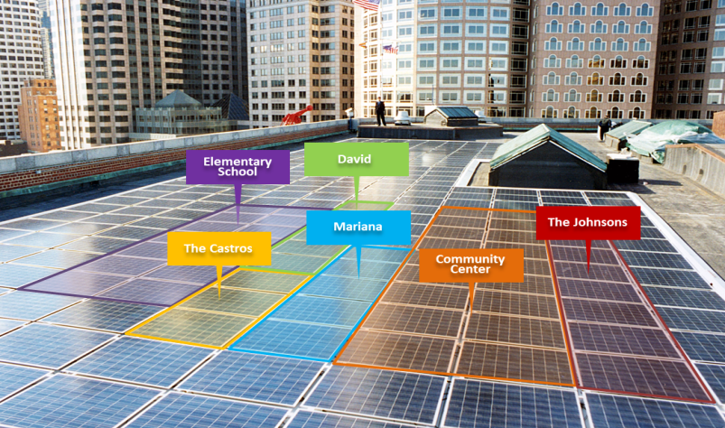
Community Solar

Slide 10
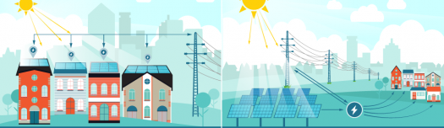
Community Solar
Recent Market Success
New York
Minnesota
New York Times: https://www.nytimes.com/2018/07/12/realestate/apartment-dwellers-solar-power.html
“guaranteeing a 10 to 15% reduction to a customer’s monthly electricity bill”

Slide 11
SWOT
Strengths: In-house solar & battery expertise Huge existing customer base Brand recognition | Weaknesses Tesla new to Community Solar
Opportunities: Untapped Market Potential Cost Savings to Customers | Threats Several Incumbents (potential partners?)

Slide 12
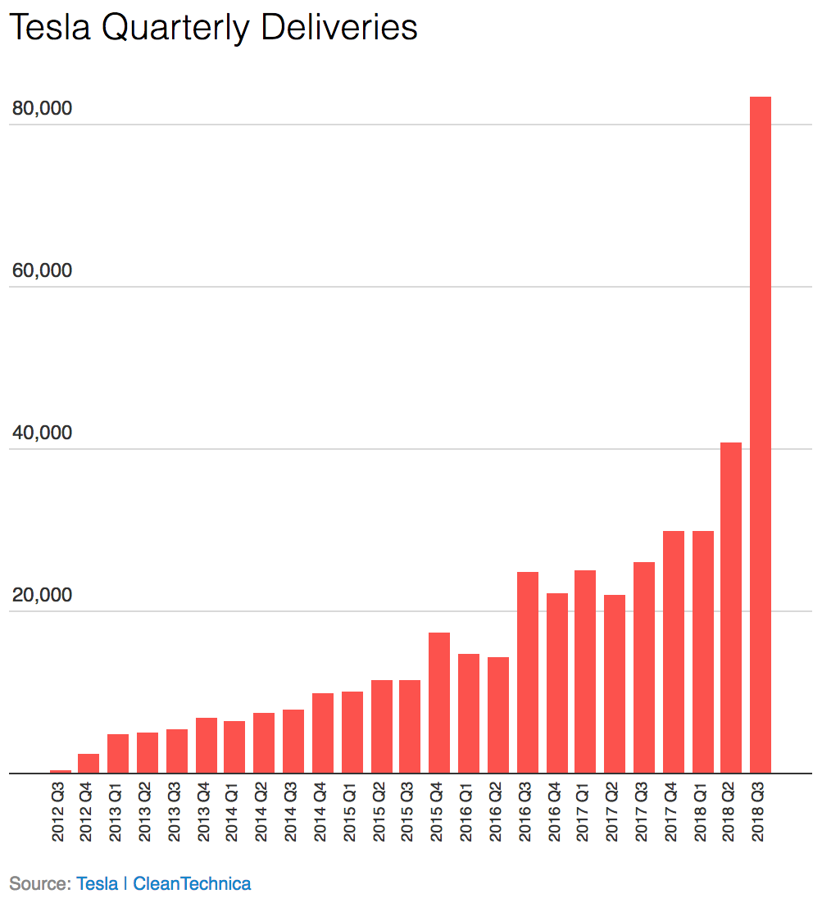
Tesla Customers
As of Q2 2018: 500,000 vehicles sold in the US alone

Slide 13
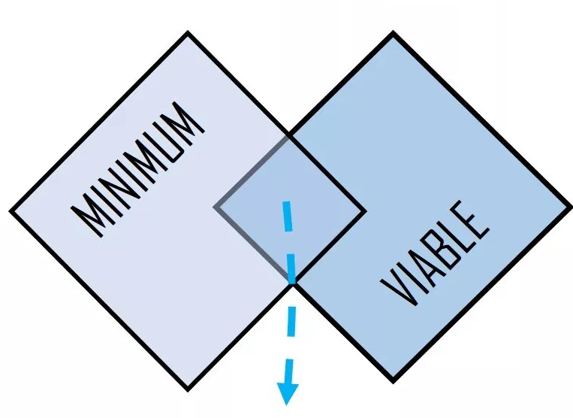
Minimum Viable Product
Cross-sell to existing Tesla car owners in select markets

Slide 14

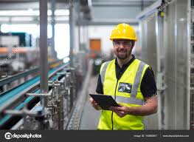

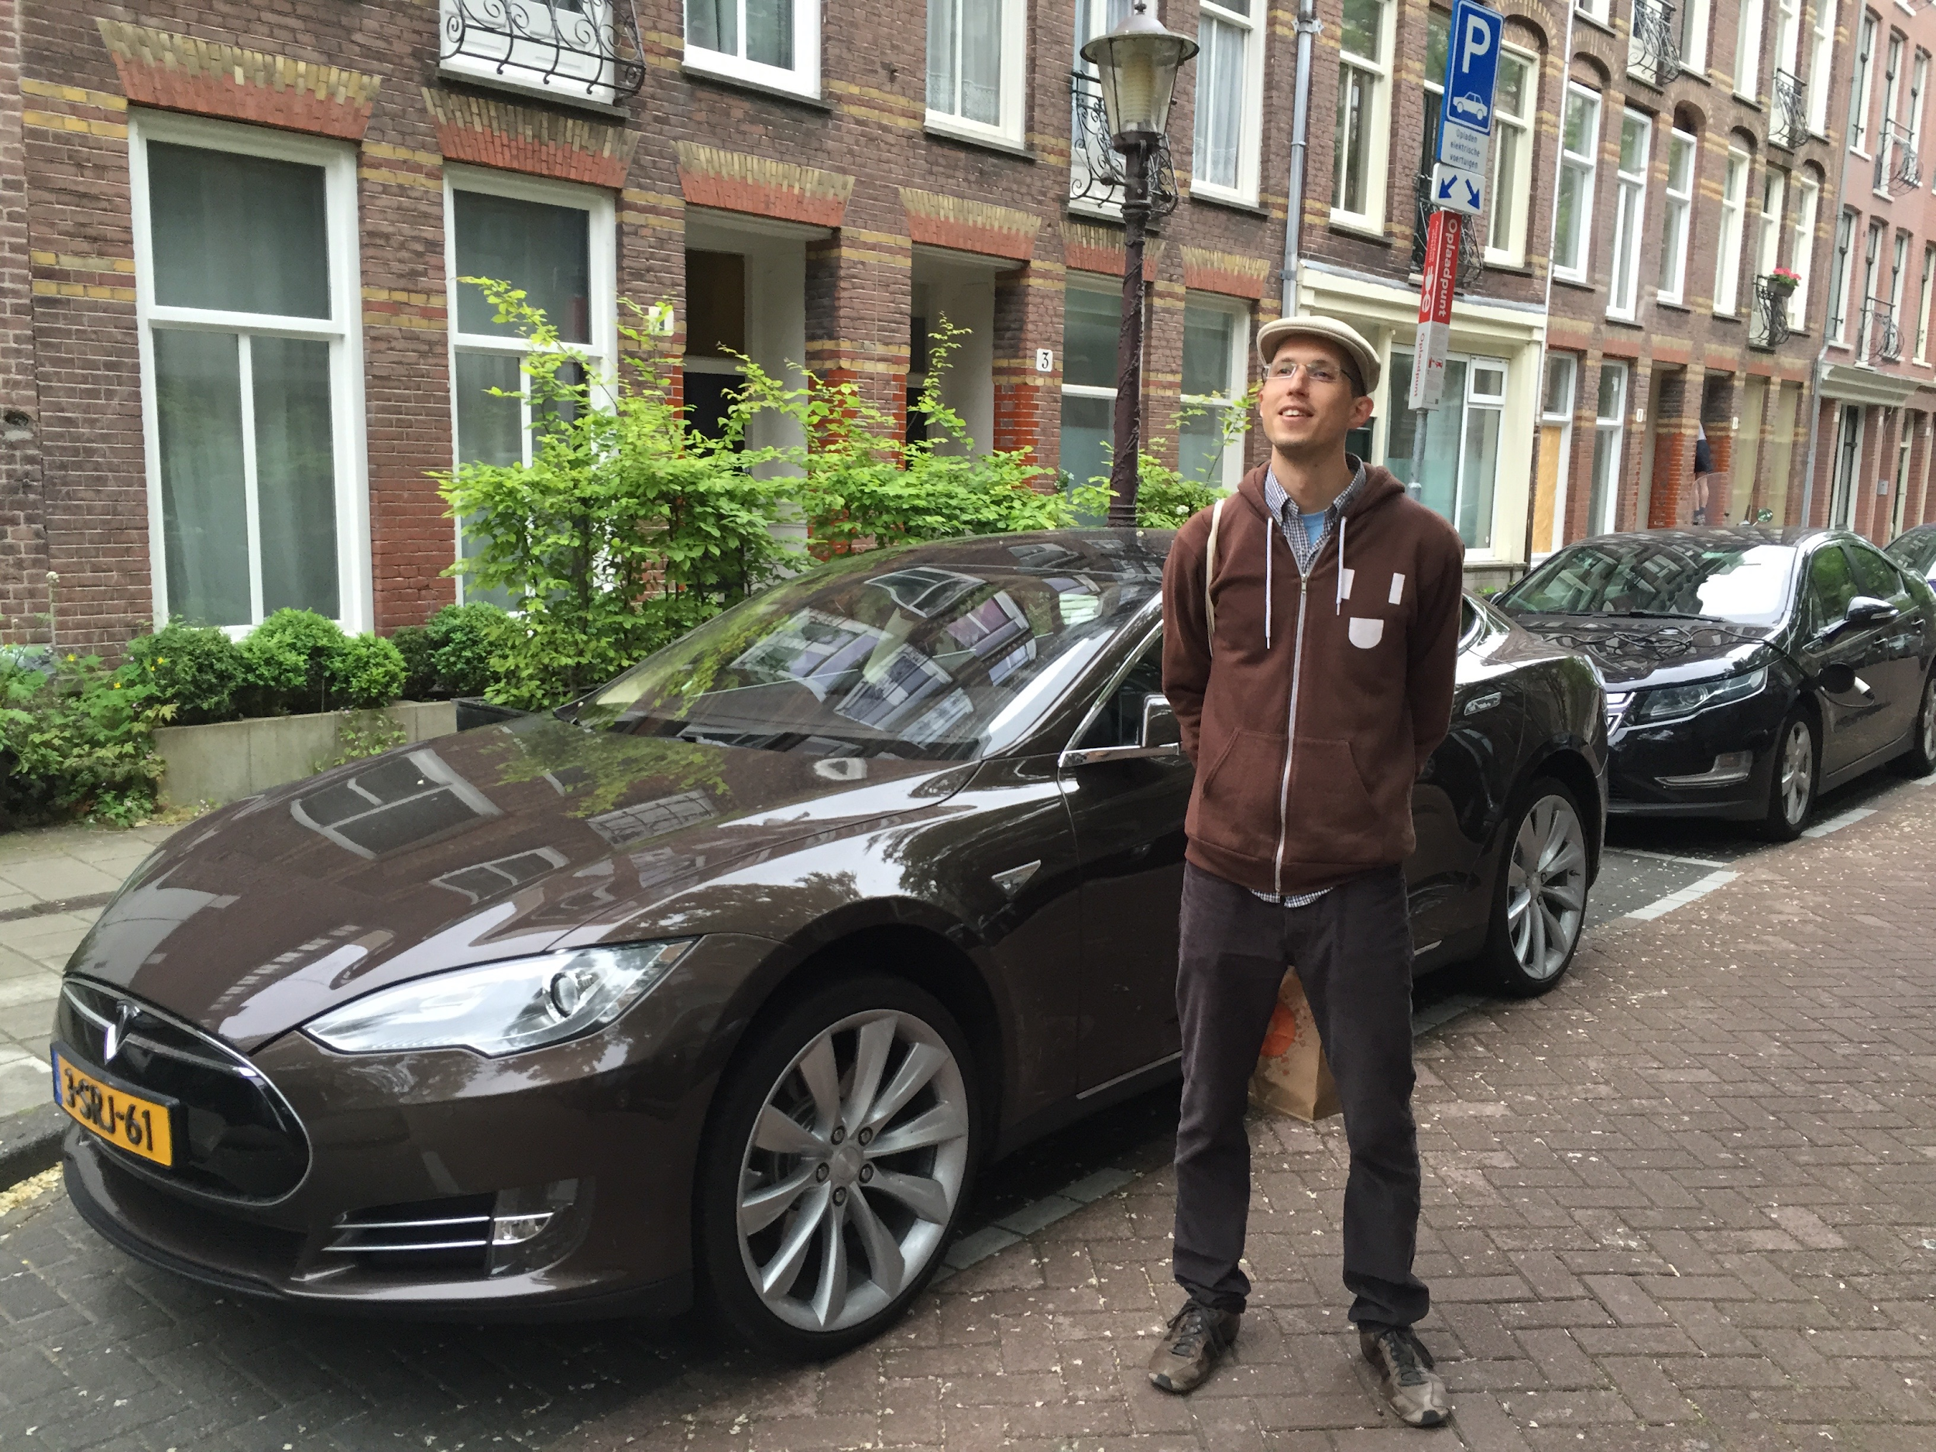
Target Personas

Slide 15

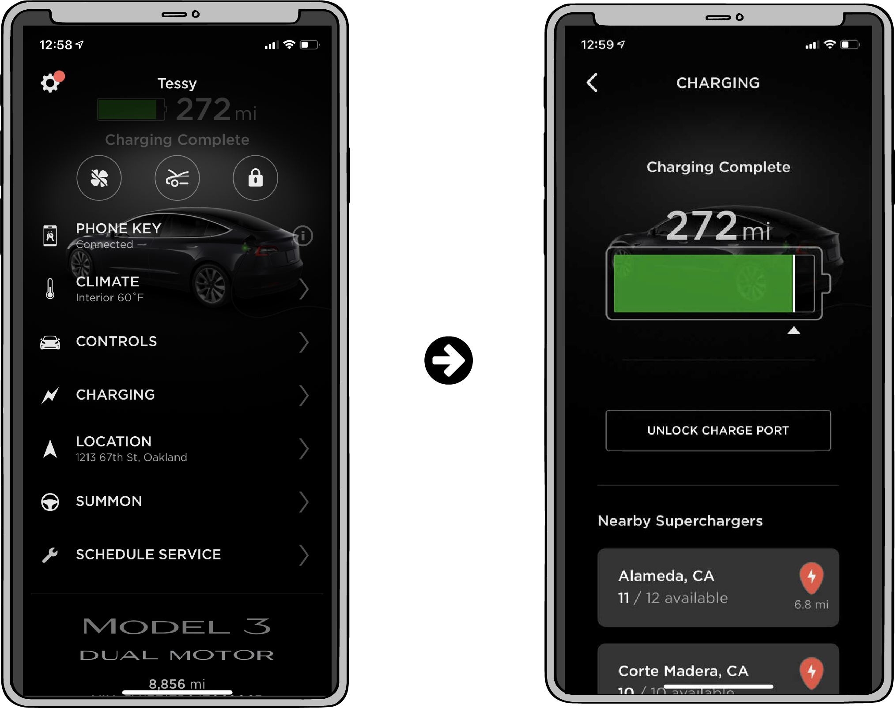
Tesla Mobile App

Slide 16
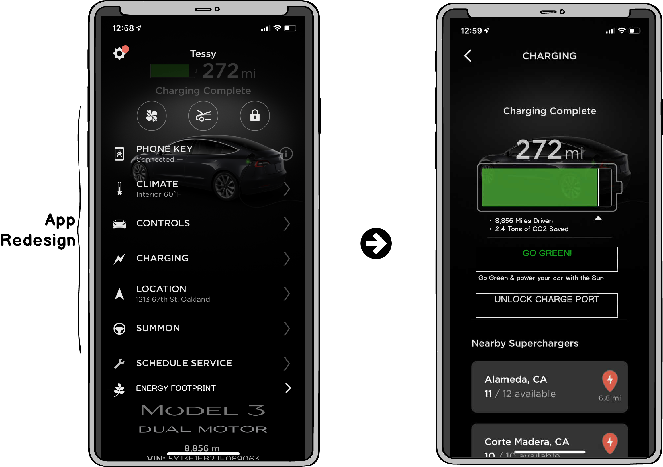
Updates

Slide 17
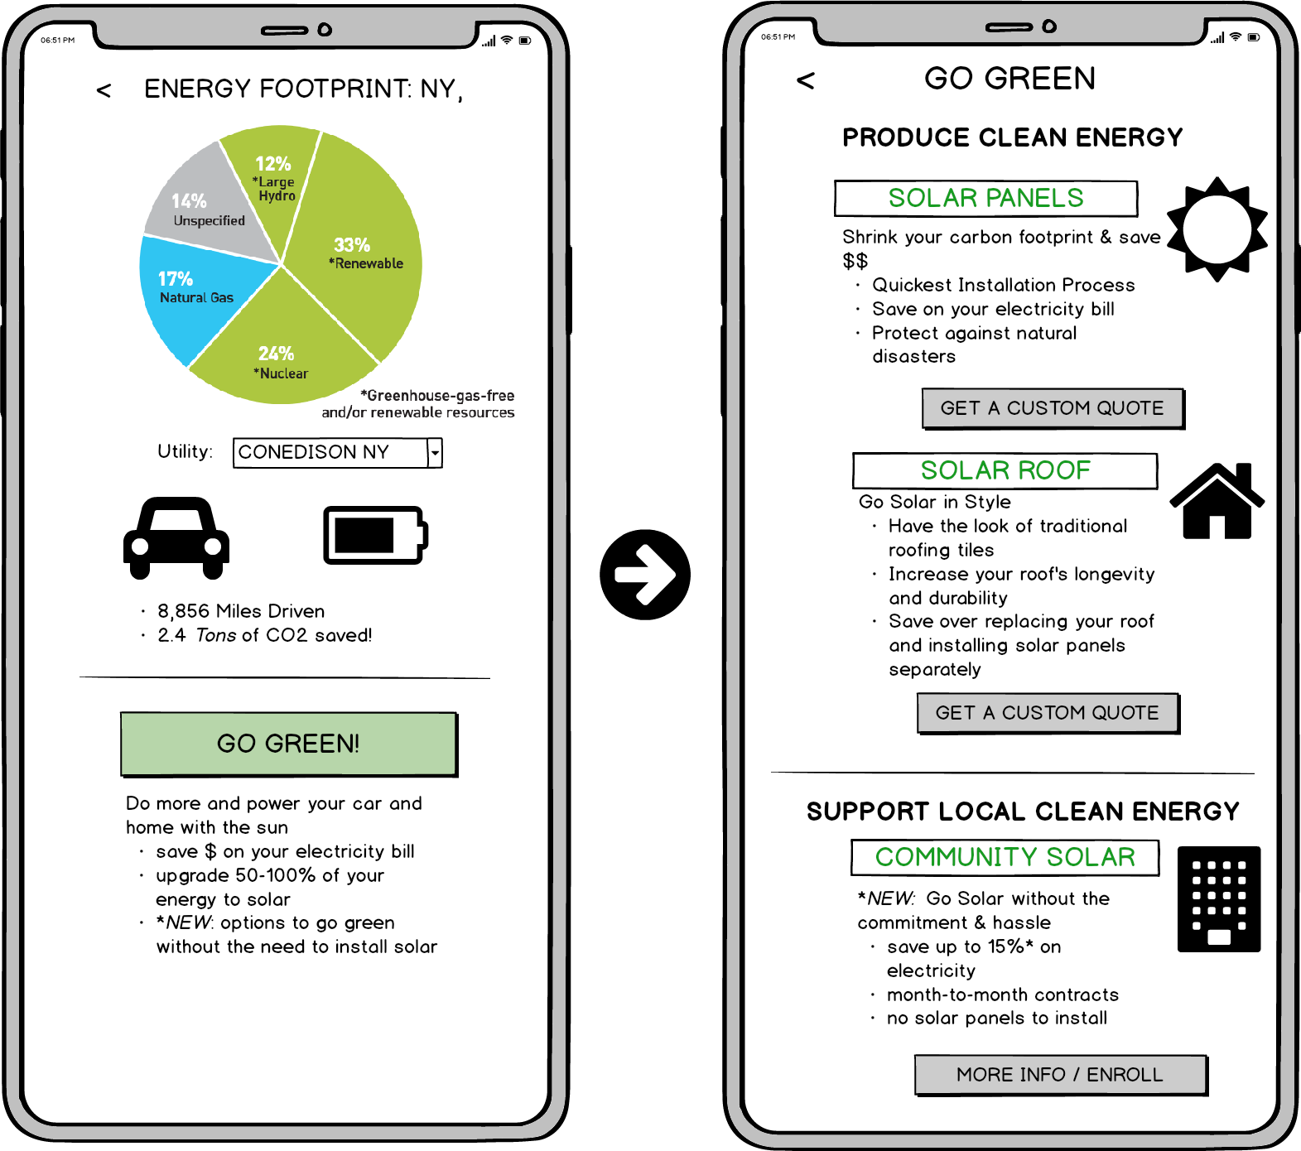
New Pages

Slide 18
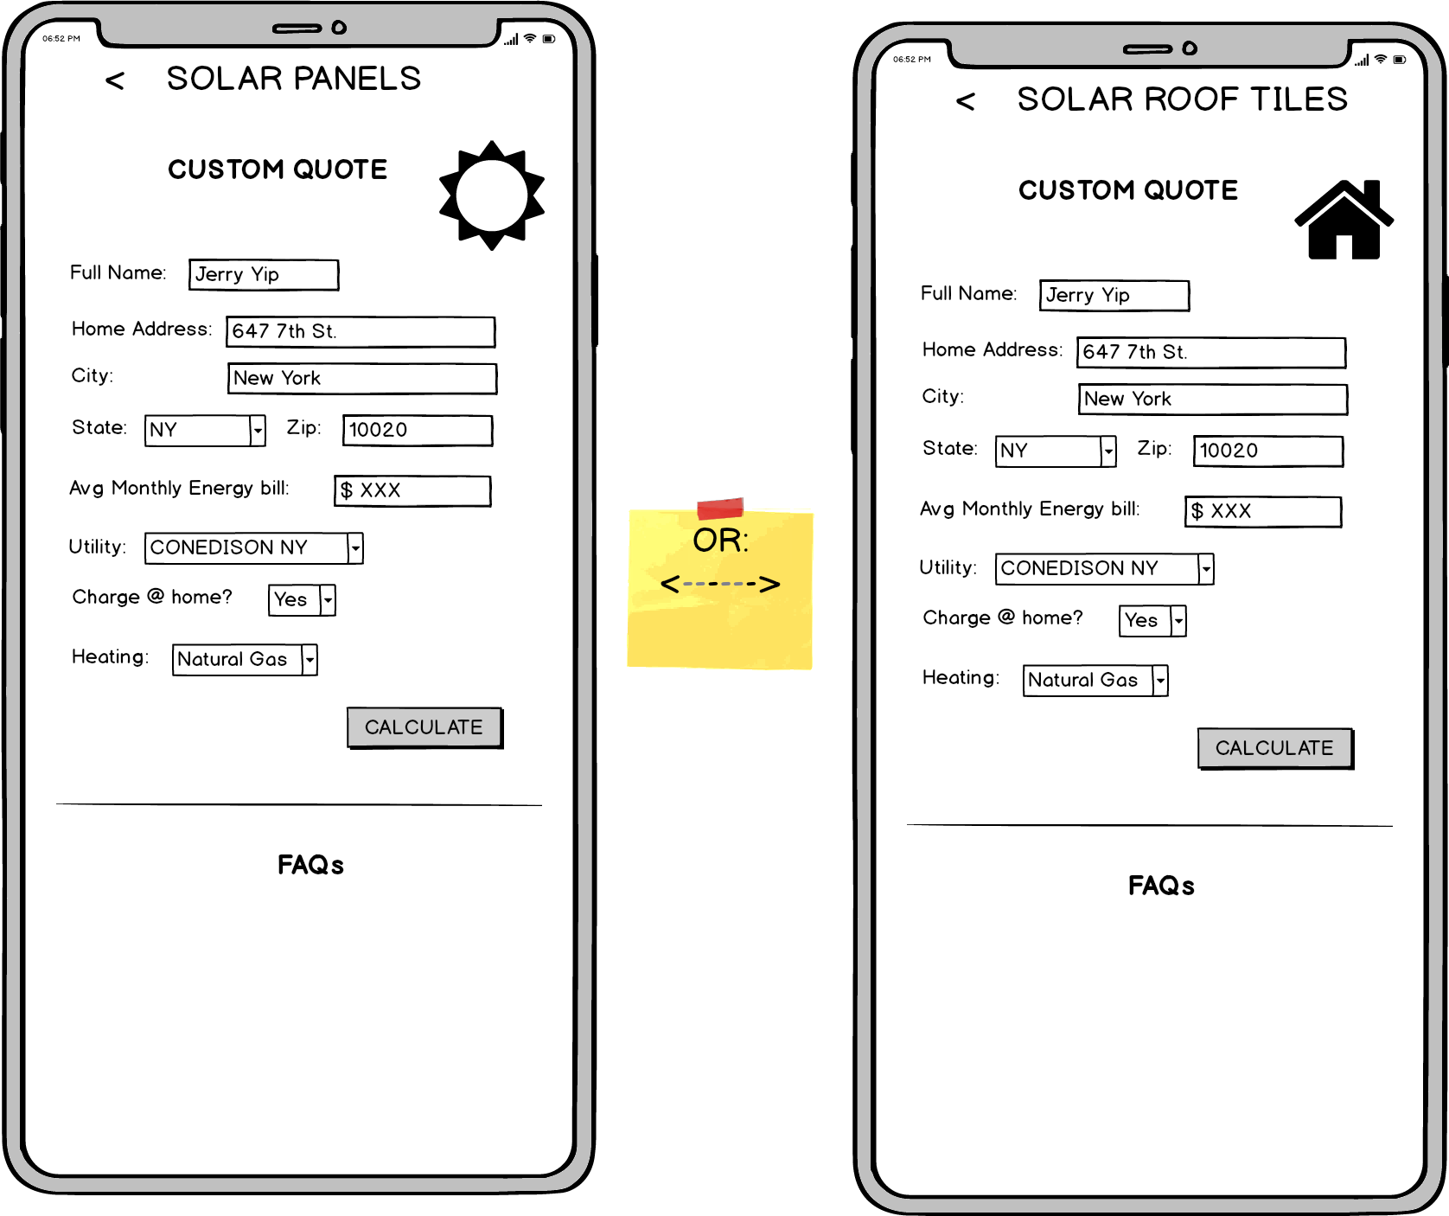
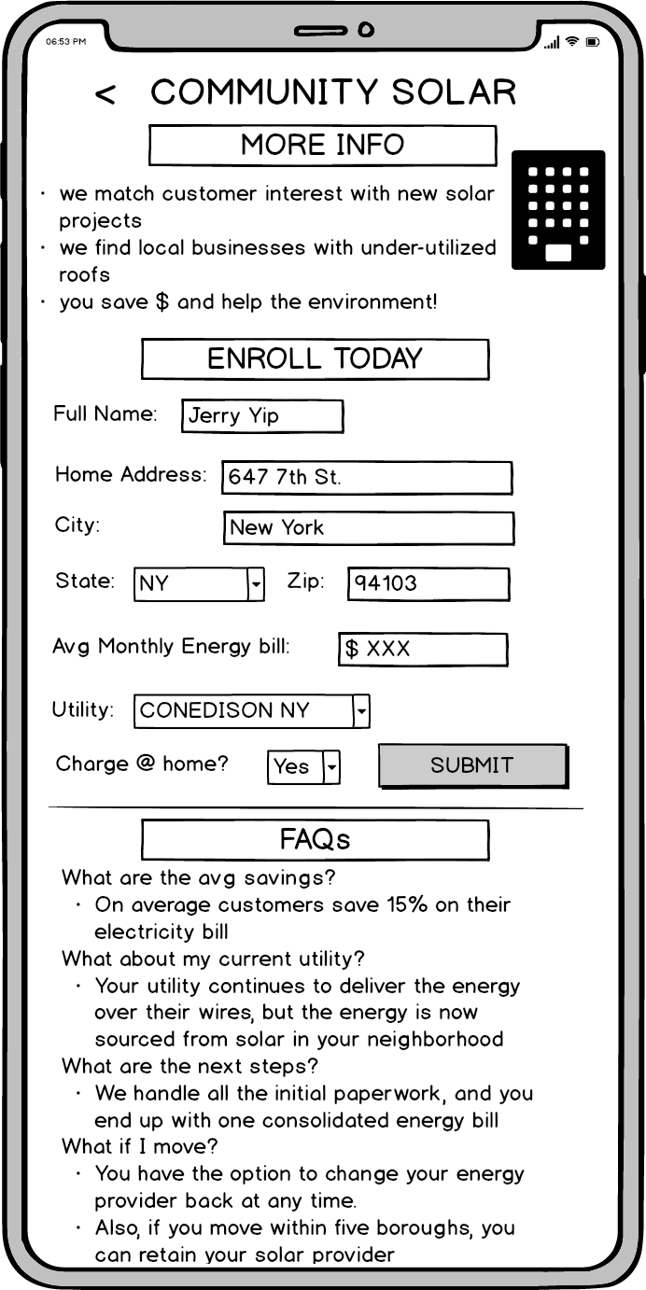

New Pages (cont.)

Slide 19
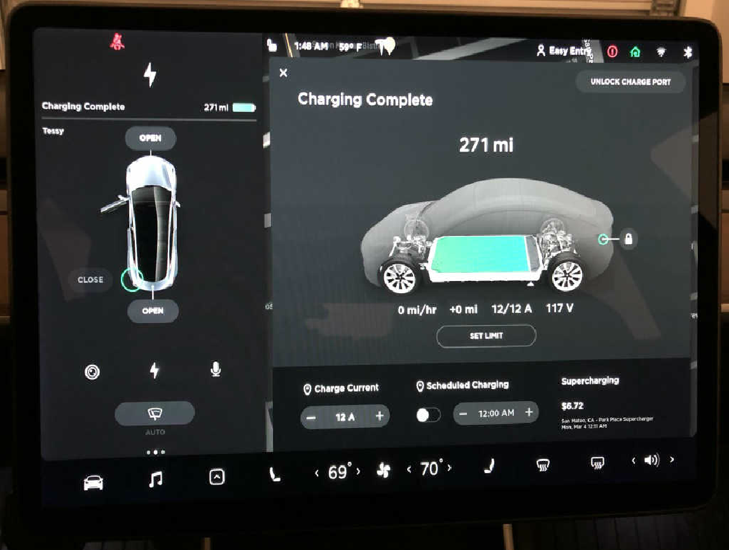
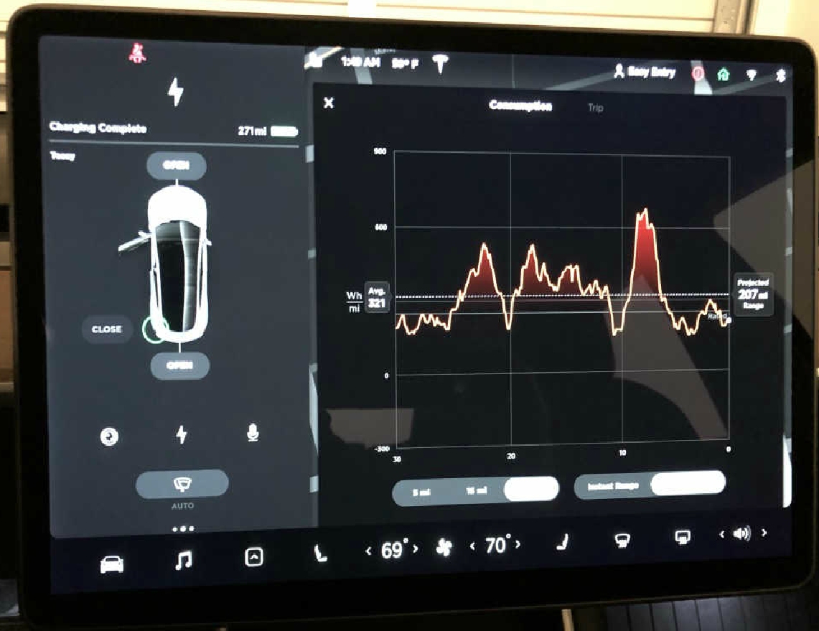
Beyond the MVP

Slide 20
Success Metrics
Number of customers who submit a request to enroll in community solar
Number of community solar projects started
Number of MWs of solar capacity and storage installed for community solar projects
Total number of new Tesla customers who install Tesla solar and batteries on their residence (whether individually or as part of community solar project)
Total MWs of solar installed

Slide 21
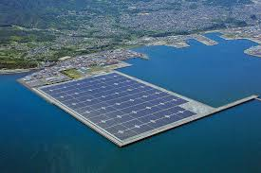
Earth’s Power Plant
Future markets:
California
Rest of US
Internationally
Notes:
“You only need about 100 miles by 100 miles of solar panels to power the entire United States. The batteries you need to store the energy, to make sure you have 24/7 power, is 1 mile by 1 mile. One square-mile. That’s it.” — Elon Musk

